Slide 1


Path to Success in XM Cloud Certification
Presentated by Vishal Khera
Sr. Sitecore Developer
Sitecore XM Cloud Certified

Slide 2
SNo. | Competency | No. of questions.
1 | XM Cloud Architecture and Developer Workflow | 6
2 | Deployment of XM Cloud Projects | 8
3 | Rendering and Layout | 7
4 | Sitecore Content Serialization | 7
5 | Sitecore API’s and Webhooks | 5
6 | XM Cloud Pages | 5
7 | Security for Developers | 5
8 | Data Modeling | 7
About Exam
8 Competency Areas, 50 Questions, 100 minutes duration.
The questions are in multiple-choice format, allowing you to mark questions for review and revisit them before final submission.
Your exam result will be displayed on the screen immediately after submission.
To pass the exam, you need to achieve a minimum score of 80%.
There is no penalty for incorrect answers; there is no negative marking.

Slide 3
XM Cloud Architecture and Developer Workflow

Slide 4
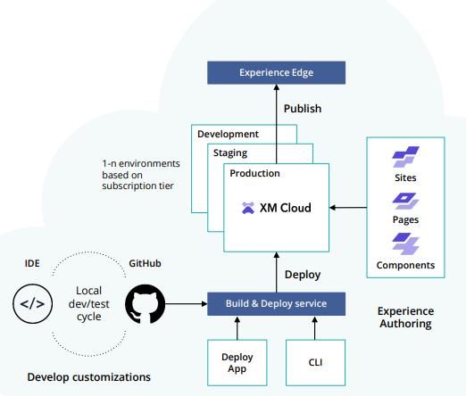
XM Cloud Terminologies
XM Cloud is a SaaS platform that includes DevOps out of the box and streamlines development and deployment. It also offers a front-end builder capabilities service called XM Cloud Components.
Features:
Scalability and Performance
Easy Maintenance and Management
Multichannel Support
Integrates Seamlessly
Content Management Instance: The hub for creating, storing, and managing site content, including layouts and permissions.
Deploy App: User interface for project management and deployment processes.
Experience Edge: is an API-based service that provides globally replicated, scalable access to Sitecore Experience Platform items, layout, and media (content retrieval via a CDN).
Site Collection: Parent item to group and share content between related sites.
Sitecore Cloud Portal: Central hub for managing DXP products and user access.
XM Cloud Starter Template: Code base for stable and up-to-date assets, resources, and components for XM Cloud projects.
Site Collection Folder
Site Collection
Site Folder
Site

Slide 5
XM Cloud Terminologies
XM Cloud Roles
Organization User
Organization Admin
Organization Owner
Organization User: Only has access to the apps that an Organization Admin or an Organization Owner assigns to them
Organization Admin: Admin role in all apps, plus additional privileges like Invite team members to the organization, manage their access to each app, and export their data.
Organization Owner: Same as Admin, plus ability to manage other Owners.
Connect XM Cloud Pages to your local XM Cloud Instance:
Open the Application panel. In the Storage section, expand the Local Storage section.
In the Local Storage panel, click the entry for XM Cloud Pages https://pages.sitecorecloud.io to reveal the local storage entries.
Create a new entry by adding a new row with the following values:
Key: Sitecore.Pages.LocalXmCloudUrl.
Value: the URL of your local XM Cloud instance. For example, https://xmcloudcm.localhost/.

Slide 6
Deployment of XM Cloud Projects

Slide 7
Deployment of XM Cloud Projects
Deployment Options
XM Cloud Deploy App
CLI
Rest API’s
XM Cloud Deploy App: is a graphical user interface (GUI) that provides a user-friendly way to create, manage, and deploy XM Cloud projects and environments.
CLI: The XM Cloud Command Line Interface (CLI) is a text-based interface that enables users to interact with the XM Cloud platform using commands.
https://doc.sitecore.com/xp/en/developers/101/developer-tools/install-sitecore-command-line-interface.html
REST APIs: XM Cloud provides a set of REST APIs that allow for programmatic interaction with the platform. REST APIs are HTTP-based and can be accessed by making HTTP requests.
https://xmclouddeploy-api.sitecorecloud.io/swagger/index.html

Slide 8
XM Cloud Deploy App
To use the XM Cloud Deploy app, you must be an Organization Admin or Organization Owner in your Sitecore Cloud Portal organization. An Organization Admin or Organization Owner can grant a team member access to the XM Cloud Deploy app by changing their organization role to Admin.
You can access the XM Cloud Deploy app at https://deploy.sitecorecloud.io/ or from the Sitecore Cloud Portal.
Key Features:
Project Creation: You can create new XM Cloud projects and associated environments.
Environment Management: It allows you to configure and manage deployment rules and settings for different environments.
Source Control Integration: You can connect to version control platforms (e.g., GitHub) and use existing source code for deployments.
GUI-Based: It's designed for users who may not be comfortable with command-line interfaces and want a more intuitive experience.
Use Case:
The XM Cloud Deploy App is suitable for organizations or individuals looking for a user-friendly, visual tool to streamline their XM Cloud project deployments.

Slide 9
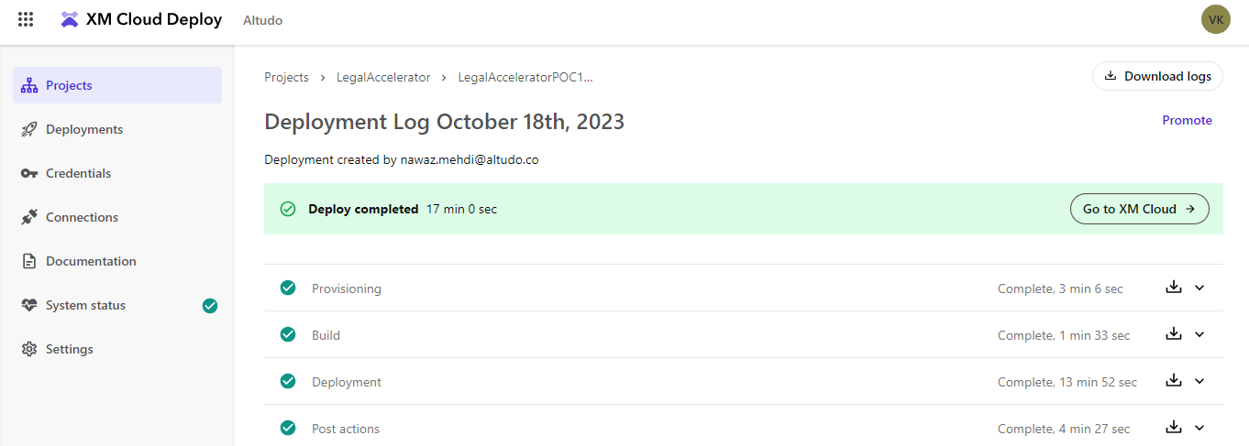
Deployment Logs
The deployment log is an essential tool for tracking and managing the progress of XM Cloud deployments.
Deployment Log: A real-time progress tracker in XM Cloud deployments.
Information: Displays deployment progress, status, warnings, and errors.
Actions: Allows you to:
Cancel a running deployment.
Rerun a failed deployment.
Promote a deployment to another environment.
Download logs.
Open the XM Cloud Dashboard.
Log Content: Provides insights into:
Provisioning.
The build process.
Deployment.
Post actions.

Slide 10
Renderings And Layouts

Slide 11
Page Structure
Partial Design
Main Partial
Header Partial
Partial Designs allow you to maintain consistency and save time when building and updating web pages. You can edit a Partial Design in one place, and those changes will automatically reflect on all pages where the Partial Design is used.
Page Design
Footer Partial
Key Pointers:
To have some control over the renderings that can be placed in a placeholder, you can set placeholder restrictions. For example, if you want the footer design to be simple, without too much information, you can restrict complex renderings.
You can link page designs to data templates. In this way, you can link your content types to your page layouts and keep the layout of your site consistent. It is very convenient to assign a page design to the template for web pages that you know you will be using a lot, so that they look consistent.
Do not add components directly to page designs. Page designs cannot hold the information on their own, but refer to the information stored in the partial designs. So if you add components directly to the page designs, they do not render on the page.

Slide 12
Building Components in XM Cloud
The Components builder of XM Cloud Components is a powerful tool that lets you create new components or modify already existing components using an intuitive WYSIWYG builder. It also lets you store the components in organized collections in the Components library.
Benefits of XM Cloud Components:
Allows designers to resize and style components.
Content authors can easily add components to site pages via the Pages application.
Integration Options:
Low-code/no-code solution for content authors and designers.
Developers can Bring Your Own Code (BYOC) by referencing an external code base.
Preview registered components in the component builder.
XM Cloud empowers users to build, integrate, and reuse components with ease, enhancing the efficiency of content creation and promoting design consistency.
https://doc.sitecore.com/xmc/en/users/xm-cloud/work-with-a-component-layout.html

Slide 13
Sitecore Content Serialization

Slide 14
Sitecore Content Serialization (SCS)
Sitecore Content Serialization (SCS) is a system for serializing, sharing, and deploying content items, as well as keeping them in version control.
The scope property is required for limit the serializatiom.
You can serialize manually or automatically:
You use manual serialization when you want to push or pull content items to or from a Sitecore instance on demand.
You use automatic serialization to specify content items that you would like to have automatically serialized from a Sitecore instance to your file system when they are created or updated.
Scope | Content Item Influenced
SingleItem | Only the Content Item
ItemAndChildren | The content item and its immediate children.
ItemAndDesendents | The content item and all its descendants.
DescendantsOnly | Only the descendants of the content item.
Default Value: ItemAndDesendents
https://doc.sitecore.com/xp/en/developers/100/developer-tools/sitecore-content-serialization-configuration-reference.html

Slide 15
Sitecore Content Serialization (SCS)
To install the serialization plugin, run the following code:
dotnet sitecore plugin add -n Sitecore.DevEx.Extensibility.Serialization
Important Commands:
dotnet sitecore serialization [subcommand]
Info Subcommand | shows serialization configuration information.
Pull Subcommand | serializes content items from a Sitecore instance to your file system.
Push Subcommand | pushes serialized content items from your file system to a Sitecore instance.
Watch Subcommand | monitors changes to content items in a Sitecore instance and automatically serializes the changes to your file system.
You can specify fields to exclude from serialization in the sitecore.json file.

Slide 16
Sitecore APIs And Webhooks

Slide 17
Sitecore APIs And Webhooks
The Sitecore Authoring and Management API is a powerful tool that simplifies content management in the Sitecore instance using GraphQL.
Key Features:
Customization and Extensibility: The API allows you to extend Sitecore Experience Manager (XM) by creating custom dialogs and user interfaces. This means you can tailor the content management experience to the specific needs of your organization or project.
Task Expansion: You can use the API to perform a wide range of tasks that were previously only achievable through the Sitecore user interface. This includes tasks like creating, editing, and managing content, as well as handling various content-related operations.
Custom Authoring Experiences: With the API, you have the freedom to design custom authoring experiences for your content authors. This allows you to build intuitive and efficient interfaces for content management.
Upgrade-Safe:Importantly: the API is designed to be upgrade-safe. This means that you don't need to implement customizations within the Sitecore instance that are complex and hard to manage when upgrading to newer versions of Sitecore XM.
Endpoint: https://<your-instance>/sitecore/api/authoring/graphql/v1/
https://xmclouddeploy-api.sitecorecloud.io/swagger/index.html

Slide 18
Sitecore APIs And Webhooks
Webhooks
You can receive real-time notifications about events or workflow actions that occur in XM Cloud, by adding a webhook. You can also use a webhook to run external validation on item workflow state changes.
You can create a webhook that tracks a system event or workflow action. When a tracked event occurs or a workflow action runs, XM Cloud sends event details in an HTTP POST request to a specified endpoint. The webhook request payload can be sent as JSON or XML.
https://doc.sitecore.com/xmc/en/developers/xm-cloud/walkthrough--creating-and-configuring-a-webhook-event-handler.html
In XM Cloud, there are three types of webhooks:
Webhook event handler | you can configure a webhook event handler to send a request to a specified endpoint when an item with the webpage template is created.
Webhook submit action | you can insert a webhook submit action in the approved state of a workflow. Then when an item using the workflow moves to the approved state, the webhook sends an HTTP request to a specified endpoint.
Webhook validation action | you can add a webhook validation action to a command item of a workflow that changes the state from in review to approved. When the command is executed, the webhook sends an HTTP request to the specified endpoint. The endpoint must then return a response validating the command. If the endpoint does not validate the command, the item will not change its state.

Slide 19
XM Cloud Pages

Slide 20
XM Cloud Pages
Pages
XM Cloud Pages is a WYSIWYG (What You See Is What You Get) editor that allows you to easily make changes to items that are visible on a page such as text, graphics, logos, and so on. In the Editor tab, you view the page as it will appear on your website when you publish it.
In Pages, you can create new pages based on page templates, and you can edit existing pages. You can add components to the page, and you can write and edit content directly on the page. While you are editing a page, you can switch between different device layouts to see what the page looks like on different devices.
Components
Sitecore components - designers can create components in XM Cloud Components and stage them for use in XM Cloud Pages. Sitecore components can display static or dynamic content from any external data source, including Content Hub ONE. You can configure a Sitecore component using the settings available in the right-hand pane, and style them with the themes created in the XM Cloud Components Styles.
Benefits of XM Cloud Components:
Allows designers to resize and style components.
Content authors can easily add components to site pages via the Pages application.

Slide 21
XM Cloud Pages
Publishing to Experience Edge
When we create a website with Sitecore, we create various types of content items. These items are published to Sitecore Experience Edge as web pages, site layout, navigation, and other elements; you render your website by using a lightweight JSS front end that consumes its content from Edge.
Best practice: Workflows
Sitecore strongly recommend implementing workflows to control publishing. If you rely on manual publishing instead, you might accidentally publish content before it's ready.
The publishing pipeline
The main purpose of the publishing pipeline is to convert the content management (CM) items that were selected for publishing into Edge entities. The publishing pipeline performs the following tasks to create an accurate snapshot of the content available for publishing from the CM instance
:
Calculating additional entities to publish
Calculating dependencies
Resolving dependencies
Deleting old or expired content
https://doc.sitecore.com/xmc/en/developers/xm-cloud/publishing-to-experience-edge.html

Slide 22
Security For Developers

Slide 23
Security
In XM Cloud, access security is controlled on three levels:
user - an individual user
role - a collection of users. Roles enable you to assign access rights to a group of users instead of to an individual user
domain - a collection of security accounts
With these three levels of security, you can control all user access to XM Cloud functionality and website content.
Key Pointers:
You can use roles to manage website authorization.
Roles allow the grouping of users into structured units, such as managers, sales staff, anonymous users, and so on.
This makes it easier to organize security access because you can use a single role to assign security access rights to multiple users.
Roles give you the flexibility to change permissions and to add or remove users without having to make changes to the whole website.
Deny will take precedence

Slide 24
Data Modeling

Slide 25
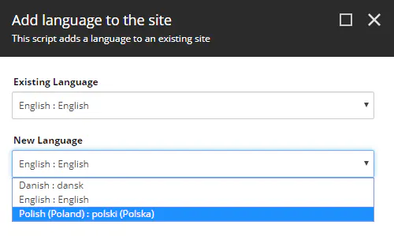
Data Modeling
Add a language version to an SXA site
You can use a script to deliver your SXA site in a different language version. The SXA language manager adds the language to all site items and copies the field values from the selected source language to a new version in the target language.
Key Pointers:
Standard values items contain all fields defined in the data template itself and inherited from base templates.
Templates are used to define data structure before creating any website.
Template Inheritance.
Effective insert options control the types of items users can insert under existing items.

Slide 26
Important Links
Official Study Guide:
https://learning.sitecore.com/partners/learn/course/1253/play/1896:710/study-guide-xm-cloud-developer-certification-exam
Practice Exam:
https://insightswithvishalkhera.wordpress.com/2023/10/31/sitecore-xm-cloud-certification-practice-exam
Exam Purchase Link:
https://www.webassessor.com/wa.do?page=enterCatalog&tabs=7

Slide 27
Q&A

Slide 28



Thank you
Contact:
Vishal Khera
Sr. Sitecore Developer
www.linkedin.com/in/vishal-khera
vishalkhera0001@gmail.com
insightswithvishalkhera.wordpress.com

